Slide 1
Navigating Water Quality Outcomes in American Watersheds
David P. Adams, California State University-Fullerton
Jonathan M. Fisk, Auburn University
John C. Morris, Auburn University
Under contract with Cambridge University Press

Slide 2
Intersectoral Collaboration
Collaboration is a…
“Process in which autonomous or semi-autonomous actors interact through formal and informal negotiation, jointly creating rules and structures to govern their relationships and ways to act or decide on the issues that brought them together; it is a process of shared norms and mutually beneficial interactions.”
(Thomspon, Perry, & Miller 2007, 25)

Slide 3
The Context & Challenge of Collaboration
Varying Boundaries – Anthropogenic and Natural
Varying Decision-Making Rules & Processes
Varying Accountability Mechanisms
Varying Time Scales
Varying Needs and Demands
Presence of Institutional Fragmentation
Presence of Incomplete but Overlapping Authority
Presence of Collective Action Dilemmas
Presence of Complexity & Uncertainty
Presence of 1st and 2nd Generation Policy Responses/Challenges
Presence of Climate Change

Slide 4
Enter Watershed Management
Emphasis begins in mid-1990s as EPA begins to enforce Total Maximum Daily Load (TMDL) provisions of the Clean Water Act §303(d) under pressure of lawsuits
Broad range of partners needed to represent environmental and economic interests and to address collective action problems
Adoption of flexible and adaptive policy tools based on scientific learning
Recognition of local conditions on the ground (and in the water) but supplemental to traditional institutions
No one way to organize collaborative activities

Slide 5
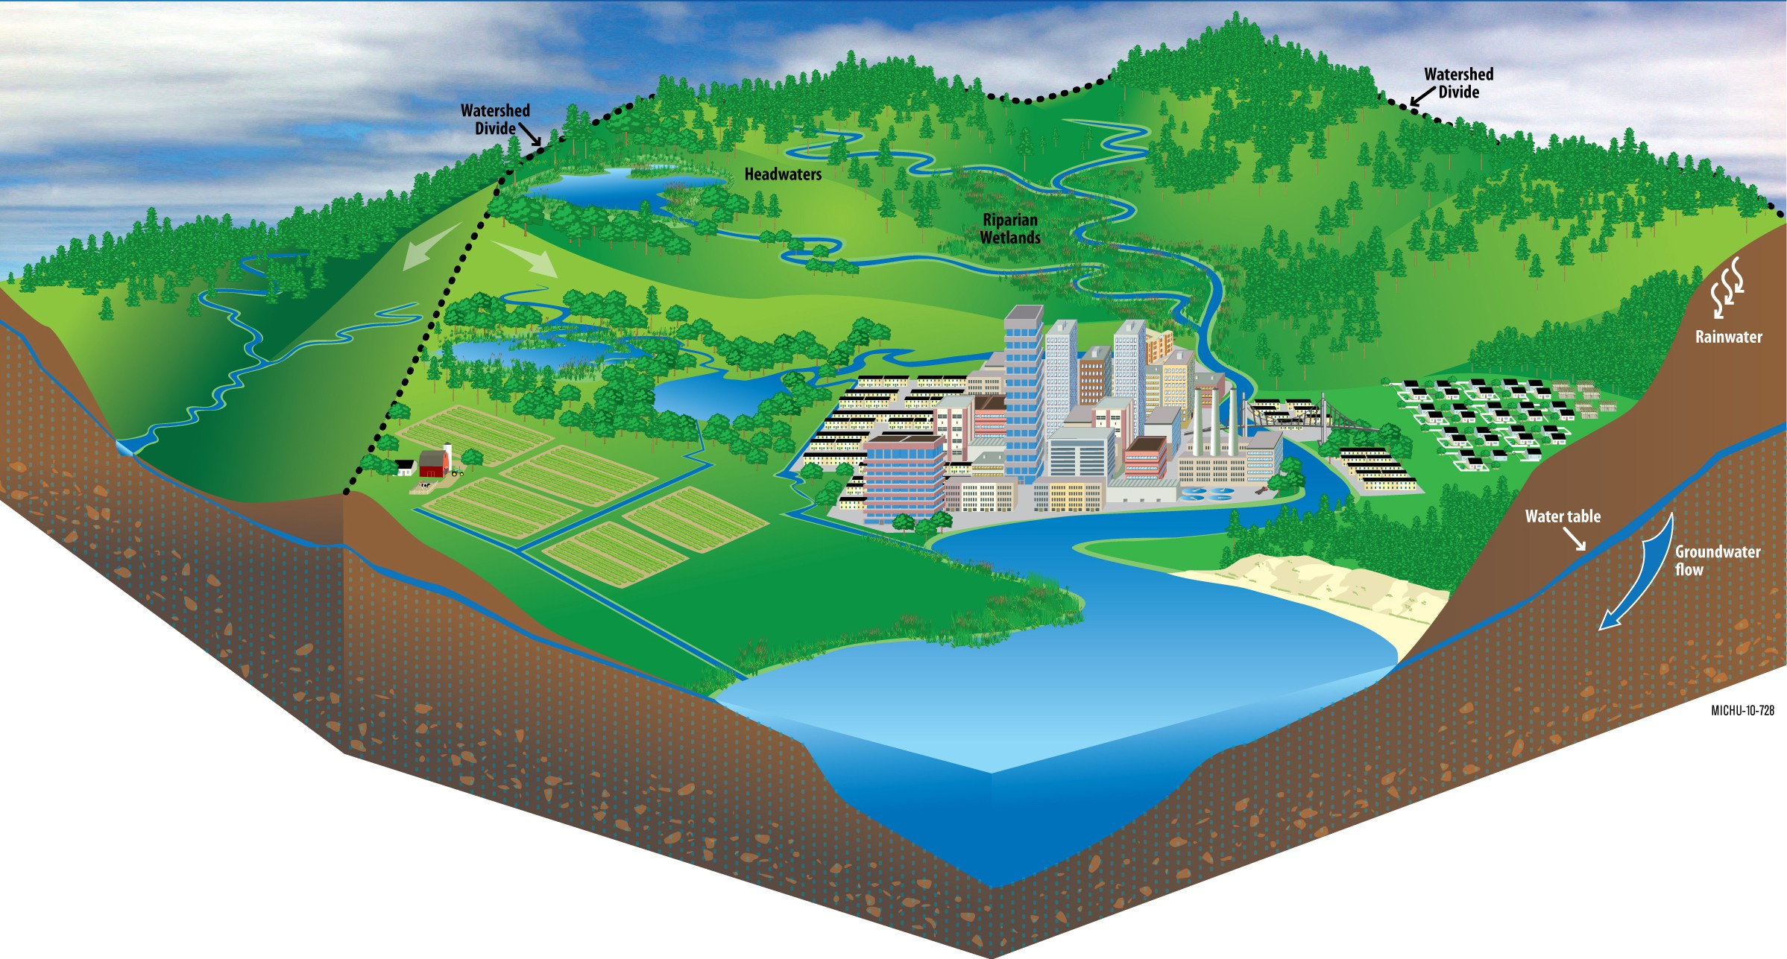
Why Watersheds…
Image from the Michigan Sea Grant Communications and Education Services.

Slide 6
Guiding Questions
Do the number and type of stakeholders impact measured water quality?
Do the number and type of stakeholders impact perceived water quality improvement?
Does water flow impact stakeholder perceptions of perceived water quality improvement?
Are stakeholder perceptions of water quality improvement associated with community characteristics?
Do collective action beliefs impact stakeholder perceptions of water quality improvement?
Do beliefs about watershed management decision-making process legitimacy impact stakeholder perceptions of water quality improvement?
Does the type and number of operational-level activities conducted in a watershed impact stakeholder perceptions of water quality improvement?

Slide 7
Our Data
Unit of Analysis: Watersheds
2,256 US Watersheds; 564 included in the sample.
4,261 Organizations — 2,795 when Duplicates Removed
1,427 Surveys Distributed; 532 Complete (rate = .36)
Dependent Variable: Measured Water Quality (TMDL Data) & Perceived Water Quality
Independent Variables:
Survey Data
State-Level - NPS Policy Activism & Water Rights
Contextual Characteristics
Initial List of Information Community from Adopt-a-Watershed
Measured Water Quality (TMDL Data)

Slide 8
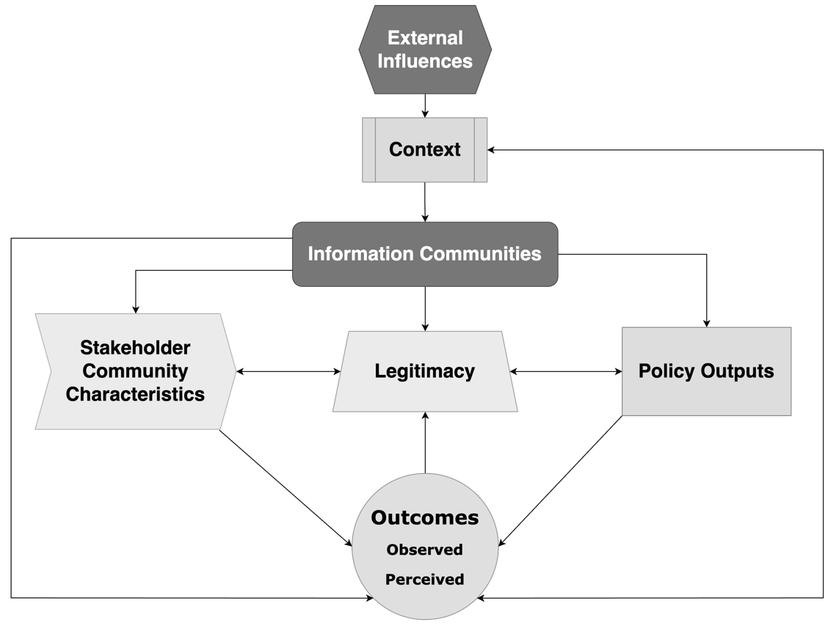
Framework and Model

Slide 9
Modeling Strategy
Phase 1: A Multilevel Mixed-Effects Modeling Approach
Watershed Level: Y_{ij} = β_{0j} + β_{1j} X_{ij} + r_{ij}
State Level:
β0j = γ00 + γ01Wj + u0j
β1j = γ10 + γ11Wj + u1j
or, more compactly,
Y_{ij} = [γ₀₀ + γ₁₀X_{ij} + γ₀₁W_{j} + γ₁₁W_{j} X_{ij} ] + [u_{0j} = u_{1j} X_{ij} + r_{ij} ], where Y_{ij} = insufficient water quality (2010).

Slide 10
Early Results
Each additional Regional NGO is associated with a 4% reduction in the percentage of insufficient water quality.
Higher percentages of white populations are associated with lower levels of insufficient water quality.
Insufficient quality in 2002 is associated with insufficient quality in 2010 (49% insufficient in 2002 versus 41% insufficient in 2010 (ρˆ = .39; p < 0.01).
State-level factors account for 30% of water quality variability.

Slide 11
Early Results
Higher percentages of white populations increase the odds of perceiving water quality improvement.
Greater population densities increase the odds of perceiving water quality improvement.
Watershed partnerships increase the odds of perceiving water quality improvements.
Odds of perceiving improvement equal .93 (CI: .85, 1.00) when a partnership is present.

Slide 12
Going Forward
Further analyze the hypothetical model (presented in the handout) to account for causal relationships between variables.
Utilize Network analysis of actors to analyze and compare relationships and water quality
Explore activities conducted beyond the on-the-ground operational-level
The Big Question: Does Collaboration Matter?
Still can’t answer it, but early results offer some intriguing clues

Slide 13
Thank You!

Slide 14
Intro. Collaboration Policy Framework Questions
Research Design in Two Phases
Data
Conclusions
Phase 2: A Binary Response Model Odds Ratio Equation
Pr(y = 1|x) Pr(y = 1|x)
= ,
Pr(y = 0|x) 1 − Pr(y = 1|x)
where y = aggregate organizational responses about whether water quality has improved (1) or not (0) since involvement in the watershed.

Slide 15
Intro. Collaboration Policy Framework Questions
Research Design in Two Phases
Data
Conclusions
Phase 2: A Binary Response Model Odds Ratio Equation
Pr(y = 1|x) Pr(y = 1|x)
= ,
Pr(y = 0|x) 1 − Pr(y = 1|x)
where y = aggregate organizational responses about whether water quality has improved (1) or not (0) since involvement in the watershed.
Phase 2: Qualitative Inquiry
Organizations asked to name most recent activity conducted related to water quality improvement.
Using pattern matching to tease out themes and trends, responses were separated by partnership membership and organizational type and then coded by operational-level activities.

Slide 16
Intro. Collaboration Policy
General Conclusions
Framework
Questions
Data
Conclusions
The results from the two phases of qualitative analysis place the emphasis on different actors.
State-level characteristics are important
Perhaps collaboratives are more likely to form when there are significant problems—problems that require long-term effort or short-term cooperation.
Perhaps those involved in collaborations were more likely to answer my survey (viz. response bias).

Slide 17
Intro. Collaboration Policy Framework Questions Data
Results from Phase 2 Quantitative Inquiry
Conclusions
Results (After Several Models)
Higher percentages of White Populations increase the odds of perceiving water quality improvement.
Greater Population Densities increase the odds of perceiving water quality improvement.
Watershed Partnerships increase the odds of perceiving water quality improvements.
Odds of perceiving improvement equal .93 (CI: .85, 1.00) when a partnership is present.

Slide 18
Intro. Collaboration Policy Framework Questions Data
Results from Phase 2 Qualitative Inquiry
Conclusions
Watershed Partnership Present
Restorative Activities Local Nongovernmental Special Districts
Educative Activities
Local Nongovernmental
Watershed Partnership Not Present
Restorative Activities
Local Nongovernmental Regional Nongovernmental
Educative Activities
State Nongovernmental

Slide 19
Intro. Collaboration Policy
General Conclusions
Framework
Questions
Data
Conclusions
Water
Humans organize around water—our habitats, our food production, our cities, our distribution of land, and our energy production.⁸
The maintenance and sustenance of water resources is an act of self-determination and self-governance.
Understanding how collaboration can lead to beneficial outcomes in the face of increased water-related crises is well worth exploration for theoretical and practical purposes.
⁸Barham 2001

Slide 20
Intro. Collaboration
Final Thoughts
Policy
Framework
Questions
Data
Conclusions
Another question throughout this whole process...
How do potential cooperators signal one another and design institutions that reinforce rather than destroy conditional cooperation?
I think it is this second-order collective action problem mechanism that really interests me.
Sorting through all the other qualitative data may start to provide clues.

Slide 22
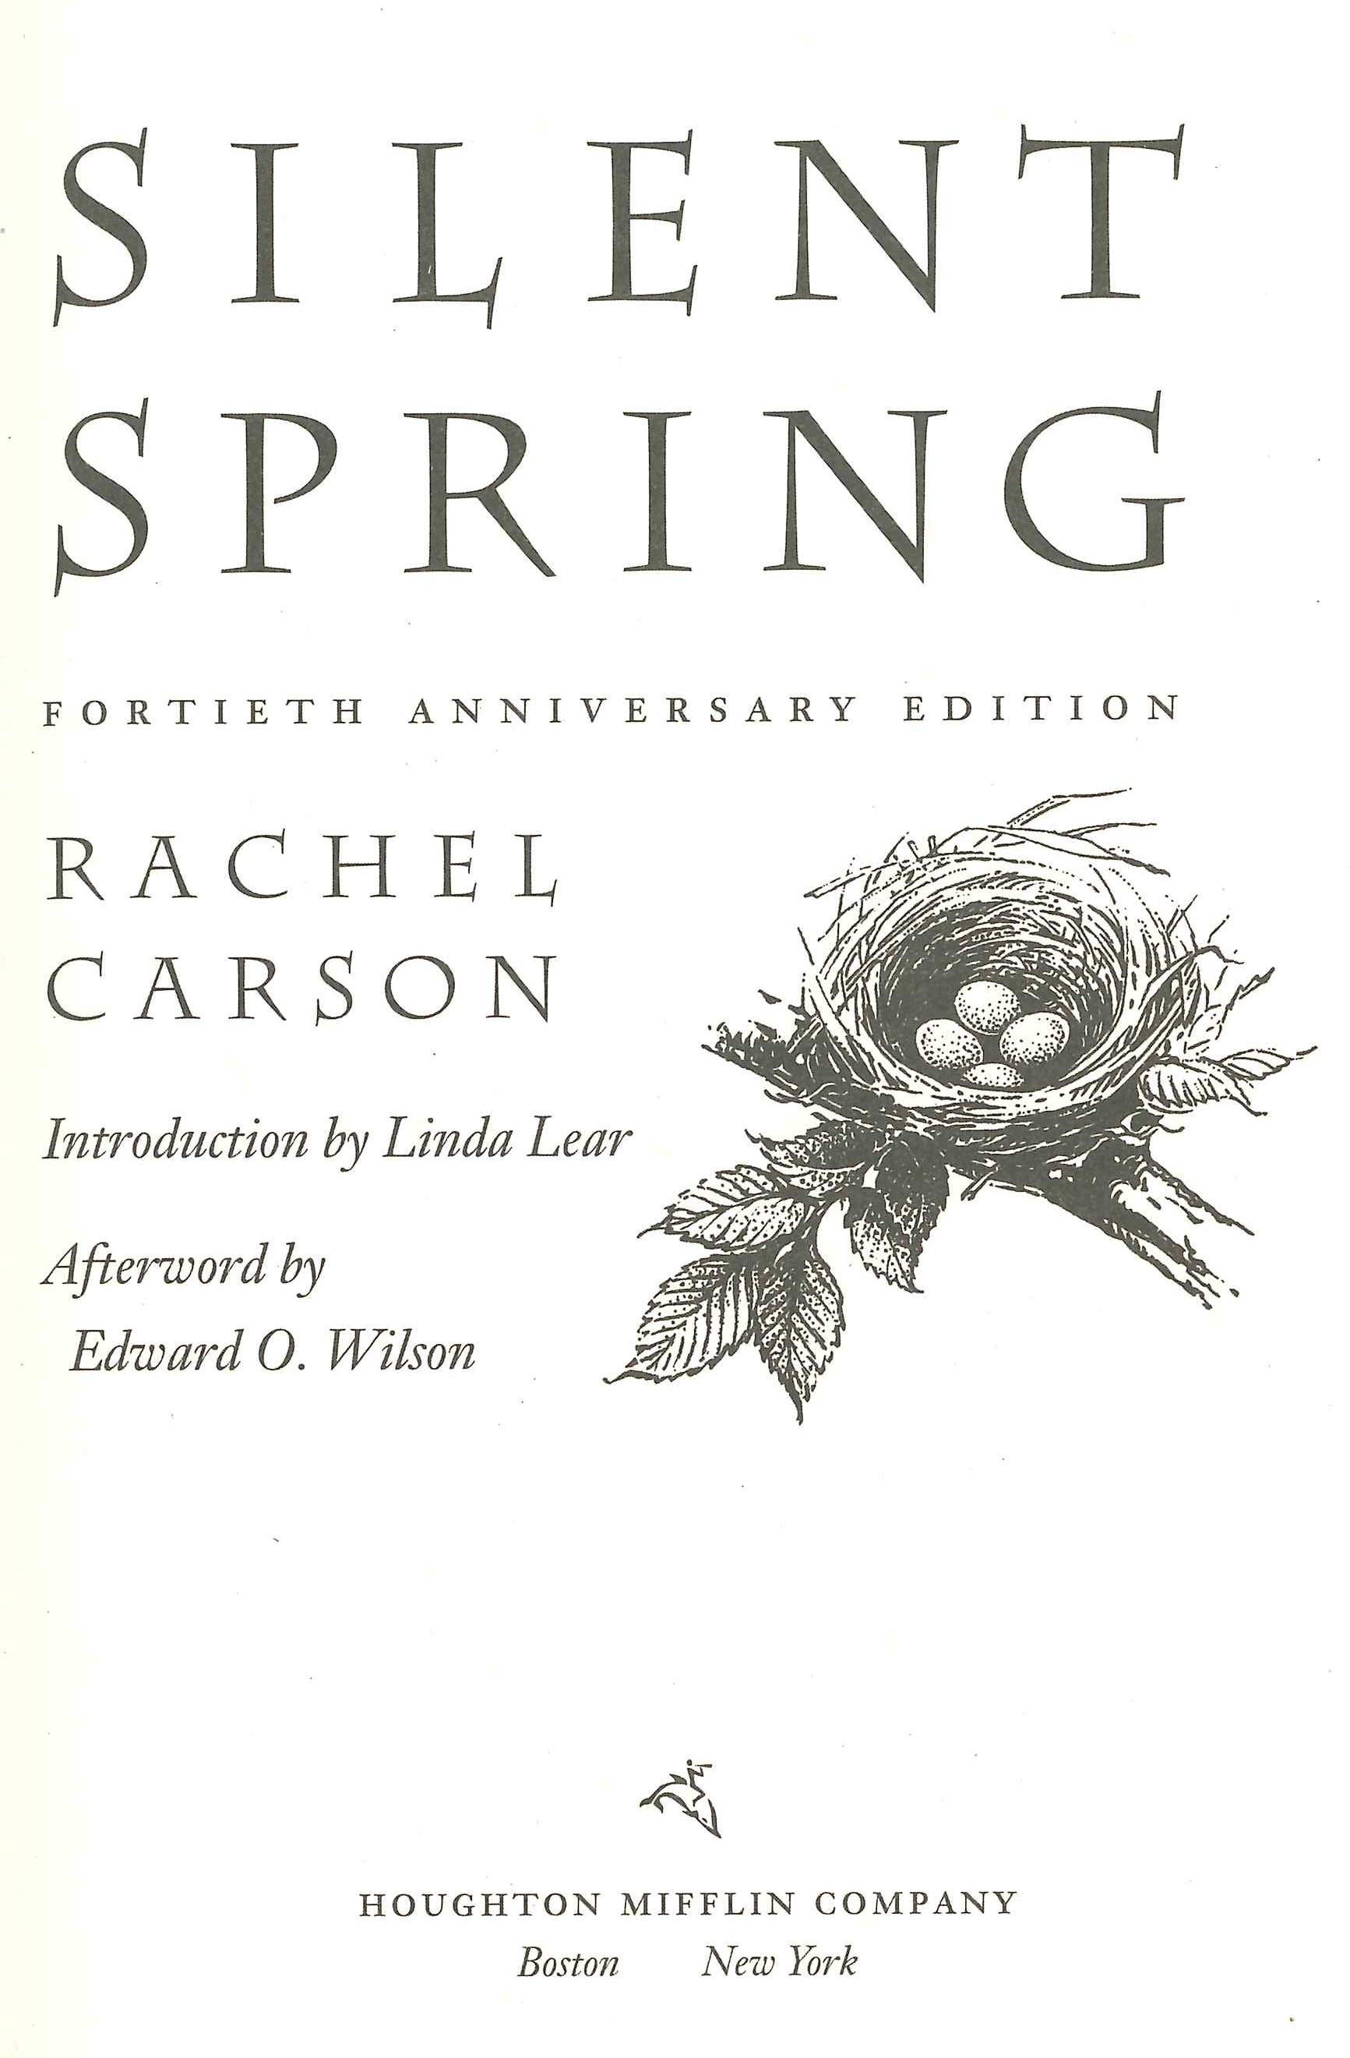
Intro. Collaboration Policy Framework Questions
First-Generation Policy Responses
Data
Conclusions
Three Streams & A Window of Opportunity ¹
Command-and-Control Institutions
Point Source Pollution Mitigation Success
Rivers rarely catch fire nowadays.
¹Repetto 2006; Webber 2008

Slide 23
Second-Generation Policy Responses
Data
Conclusion
New Challenges: Nonpoint Source Pollution
Biodiversity Restoration Sustainability
New Goals:³
Reconceptualize Purpose Reconnect with Stakeholders
Redefine Administrative Rationality
Recognize that ENR risks are “multimedia, interactive, multiple pathway, and cumulative in nature.”²
Civic Environmentalism in which people work together “community by community, watershed by watershed.”⁴
²Durant, Fiorino, & O’Leary 2004
³ibid.
⁴EPA Administrator 1996

